Slide 1

Launch Lift
NASA Space Apps 2023
Problem Statement
Designing a platform which guides science enthusiasts and other small scale startups with precise weather info suitable for rocket launch from any given region.

Slide 2
Working
We designed a website which helps to successfully recognise a opens area and predict weather conditions around the area.
Then it fetches weather conditions and compare it with suitable conditions for a successful launch.

Slide 3
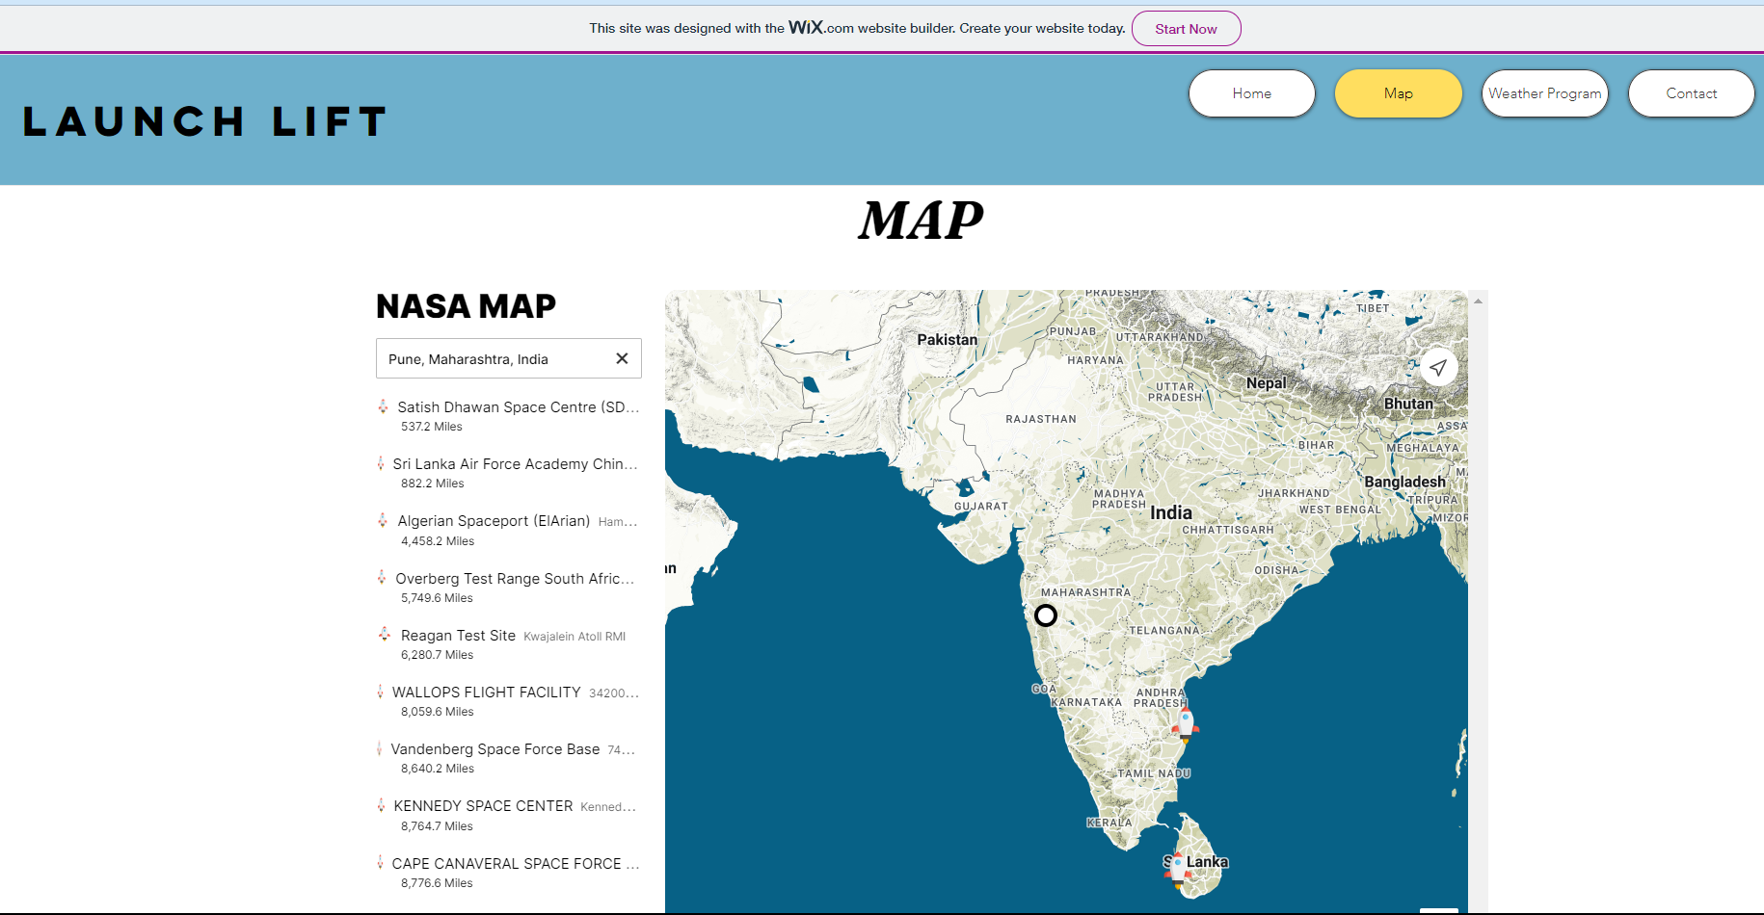
Working

Slide 4
Solution
We created a Python program to cross check the ideal conditions for the launch of a student rocket & also created a similar version on JavaScript to make a web app.
We have created a git repo for the same and is available for everyone around the globe to try it out for themselves.

Slide 5
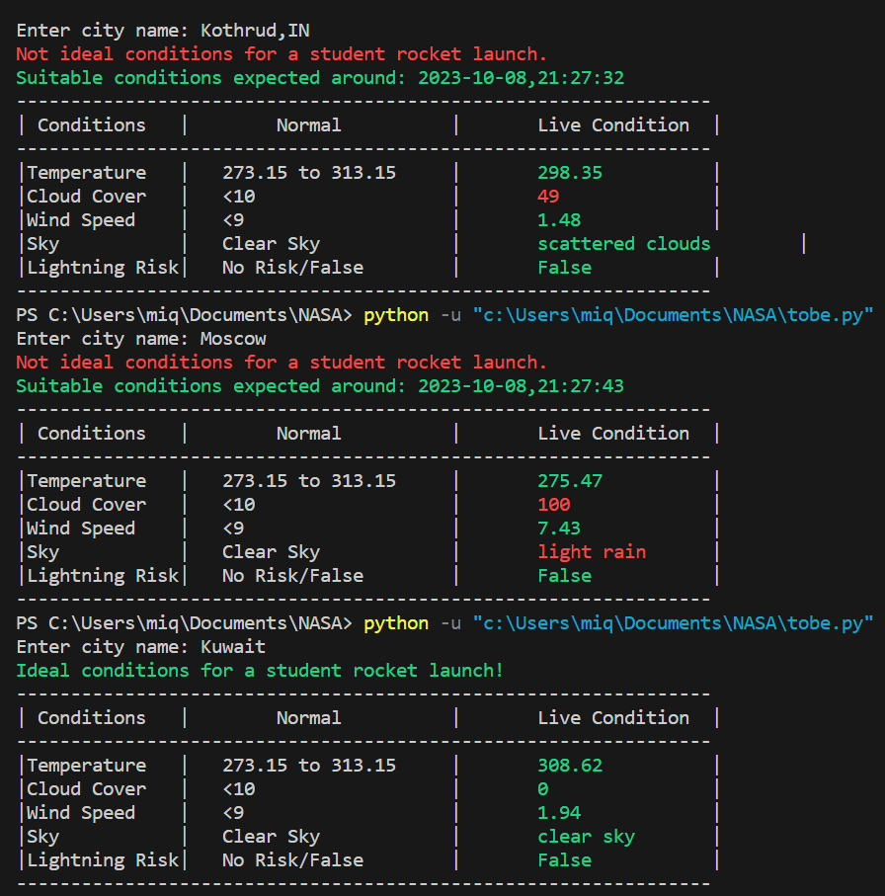
We check conditions for various cities and regions:
1. Kothrud ,Pune
2. Moscow , Russia
3. Kuwait
Shows the nearest suitable launch time that satisfies all the conditions
Kuwait weather condition satisfies all the conditions and hence shows ready to launch !

Slide 6
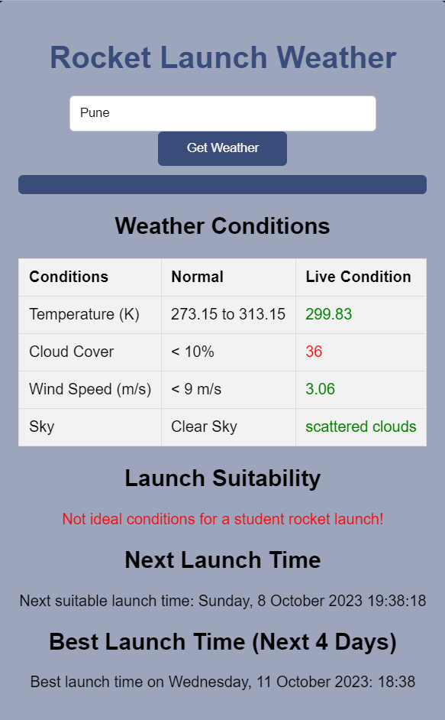
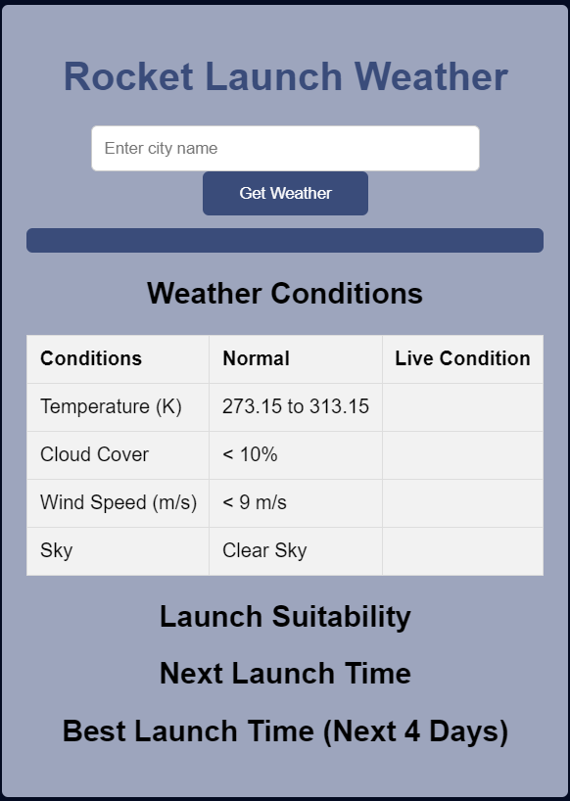
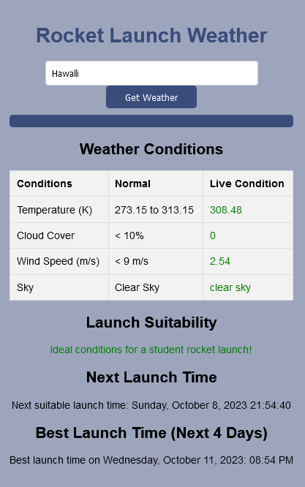
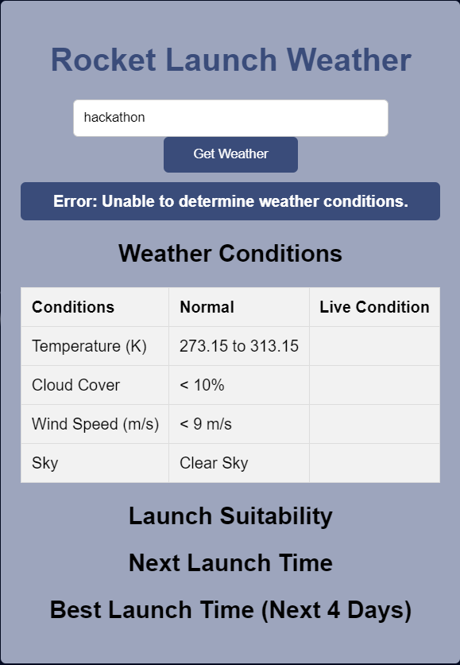
WEB APP
Error Case
Entering City
Working Case

Slide 7
THANK YOU
Project by Team Cypher

